Slide 1
Fight Covid App
Li Xia SWE1709204
Huang Jiaqi SWE1709151
Sun Ruitao SWE1709346

Slide 2
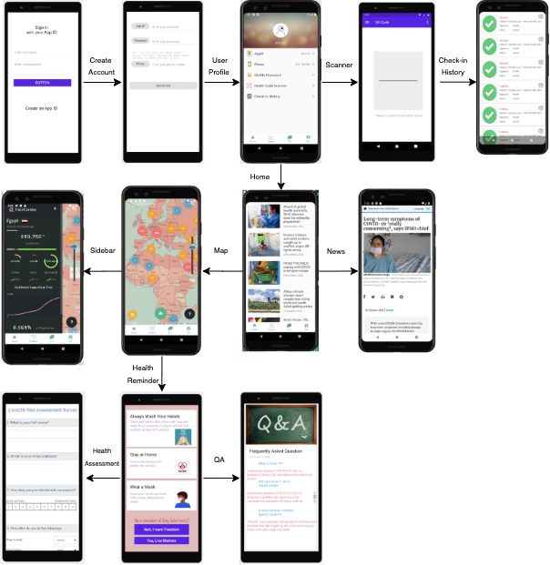
Application Flow Chart
Login -> Regiseration -> User Profile
->
Check-in Hitory <- QR Code Scanner
Home -> News
->
Map -> Sidebar
Health Reminder -> Q&A
->
Aassessment

Slide 3
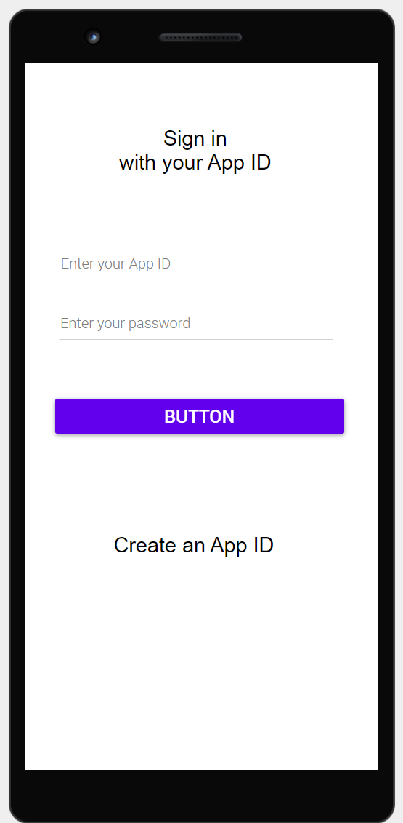
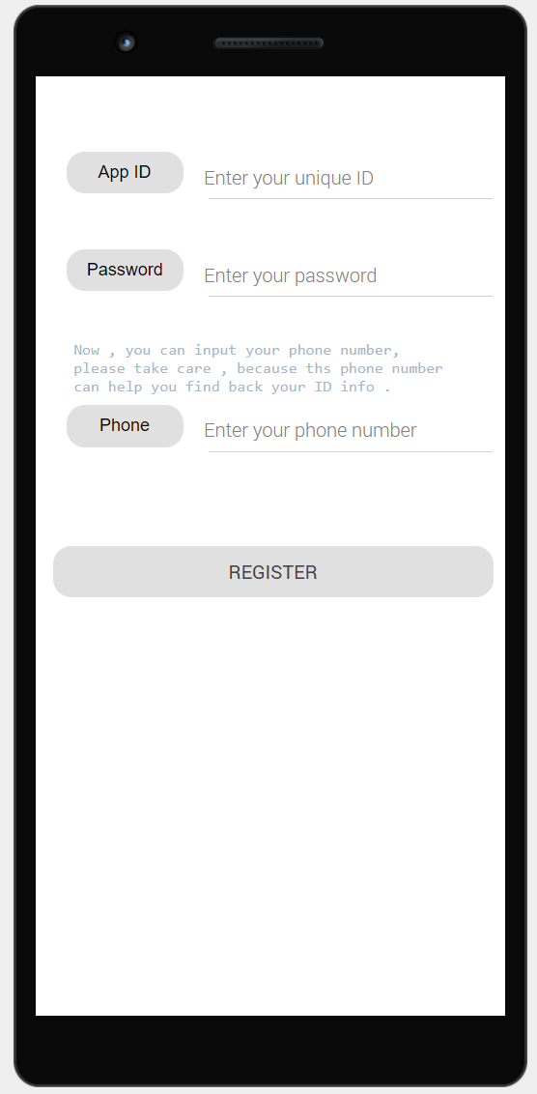
Register and Login
Basic Login Interface
Press Sign in button to sign in.
Press “Create App ID” button to create new account
Register Interface
In this section, Username, Password and Phone number is needed for registration. Particularly, if you forget your password, you can reset it using the phone number provided.

Slide 4
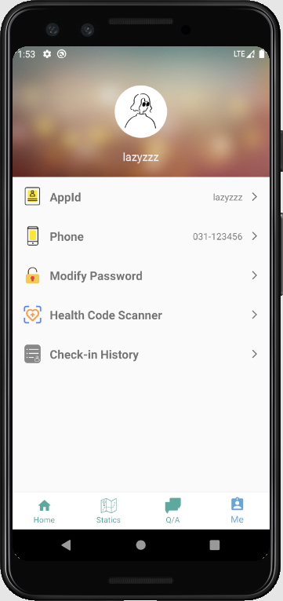
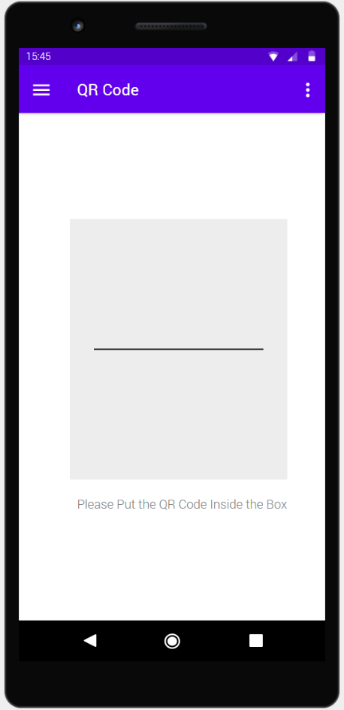
Scanner Function
Profile Interface
In this part, you can modify your account information such as: Username. Password. Phone Number. Avatar
Scanner interface
Any QR code inside the scanner box will be detected by the program.

Slide 5
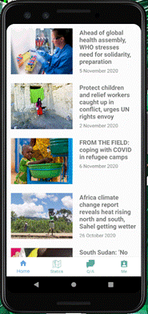
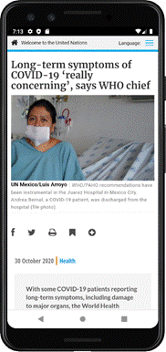
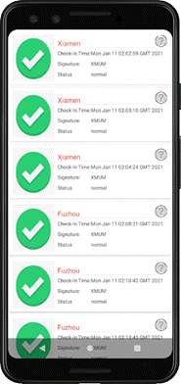
News and Check-In History
Home Interface
In this page, users can scroll down to read news related to the Covid-19. Besides, clicking on news item will open a new web page in the browser with detailed information.
News Interface
This page will be opened in the browser when users click on the news item on the Home page. It is linked to the United Nations official website, since the news data come from the Covid-19 news section of the United Nations’ official website.
Check-in History
Check-In Location
Time
Condition
Location

Slide 6
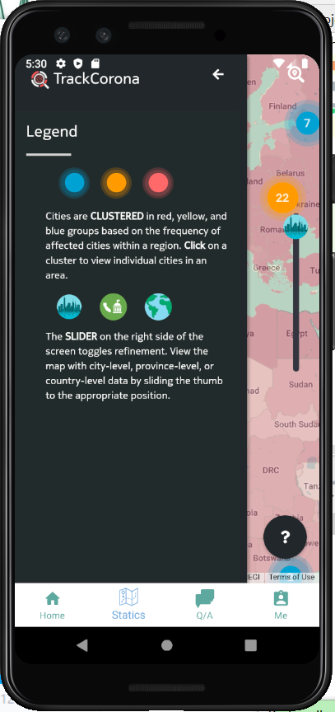
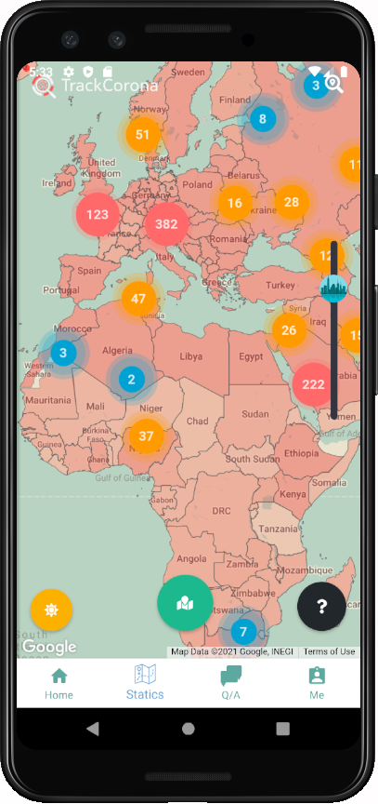
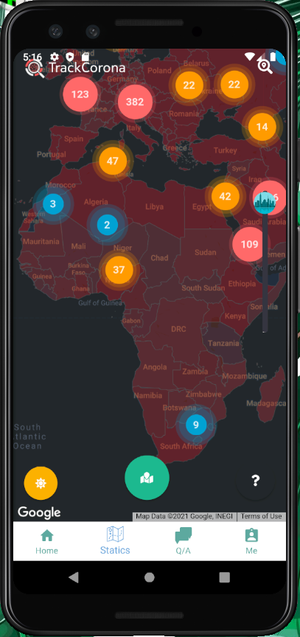
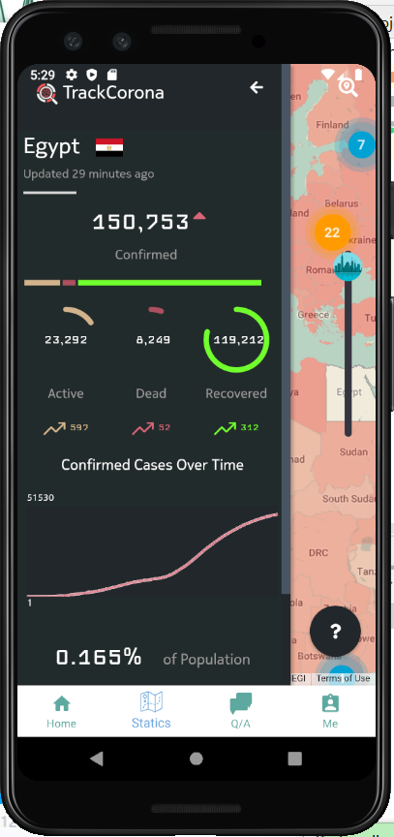
Statistics
Legend Info:
This sidebar will appear when users clicks on the question mark button on the bottom right corner of the page, which describes the Legend information.
Statistics
Sidebar
The sidebar shows the detailed statistics of the country clicked by the user. It will slide from the left once user clicks on a country in the map.
This page shows the current impact of the coronavirus pandemic throughout the world. It is implemented through a WebView that links to the Track Corona website.

Slide 7
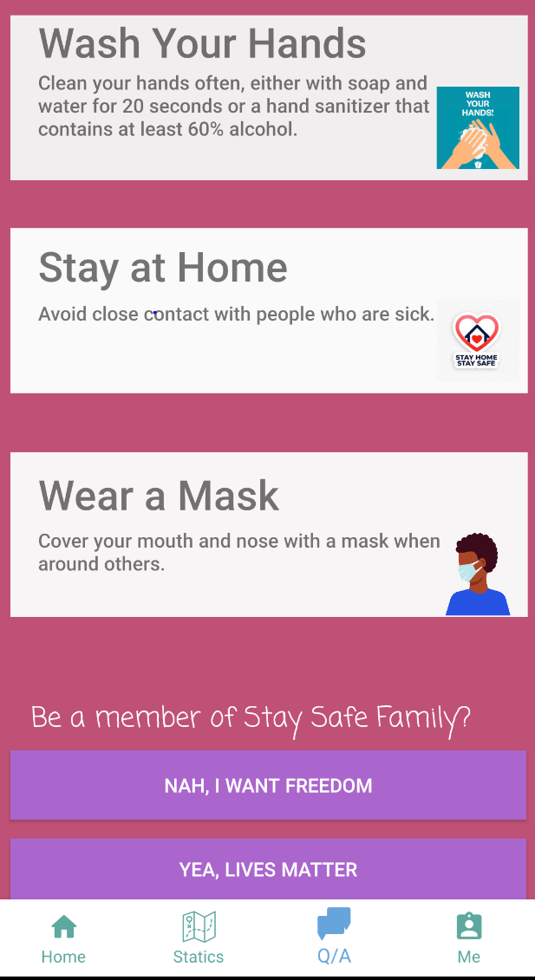
Health Reminder Page
Health Strategy
Following the guidelines like washing hands, staying at home, wearing a mask will reduce the possibility of infection.
Freedom Matters
Live Matters
Those who donnot comply to gudelines are likey to be freedom seekers, thus there will be some Q&A awaiting them
With a strong responsibility for lives, we find that is need for them to assess their health by survey

Slide 8
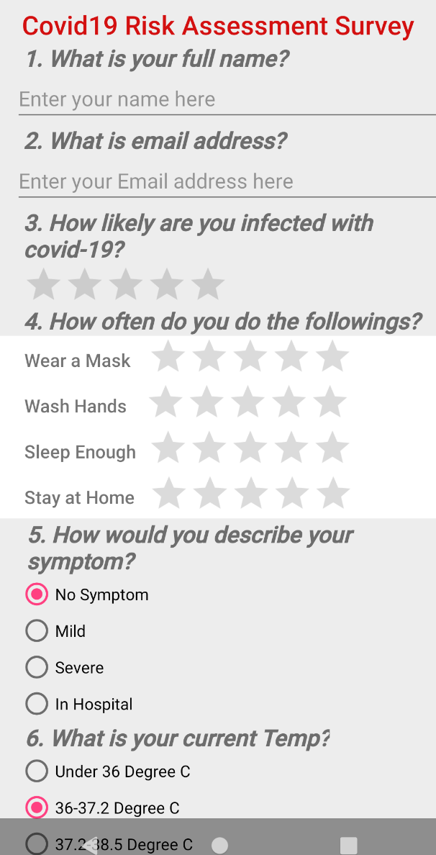
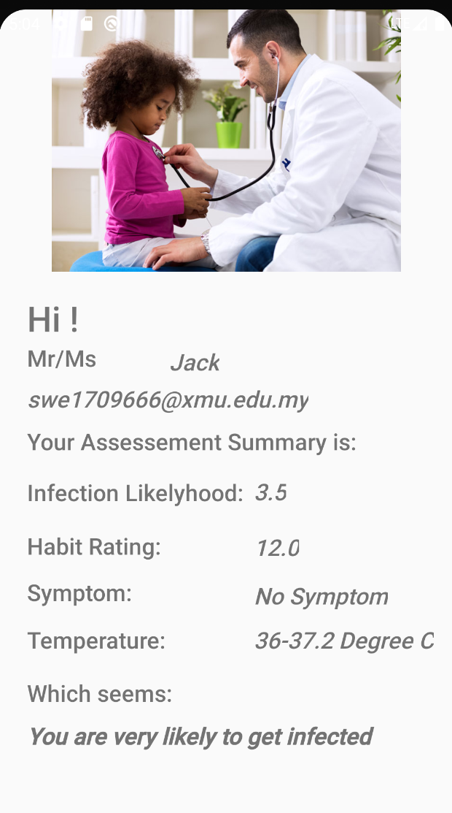
Health Assessment
Health Assessment Survey
By filling the survey, the system will genreate report and prediction
Summary Form
The summary will collect all data input and give feedback afterwards
Logics
Question 3 is Expectation and Question 4 is Prediction Metrics

Slide 9
Testing
01
03
Login
Page Switch
Verify that user can login successfully and system can reject illegal login request.
Verify the page switch is successful or not
02
04
Register
Navigation
Verify that user can register successfully.
Verify the bottom navigation.

Slide 10
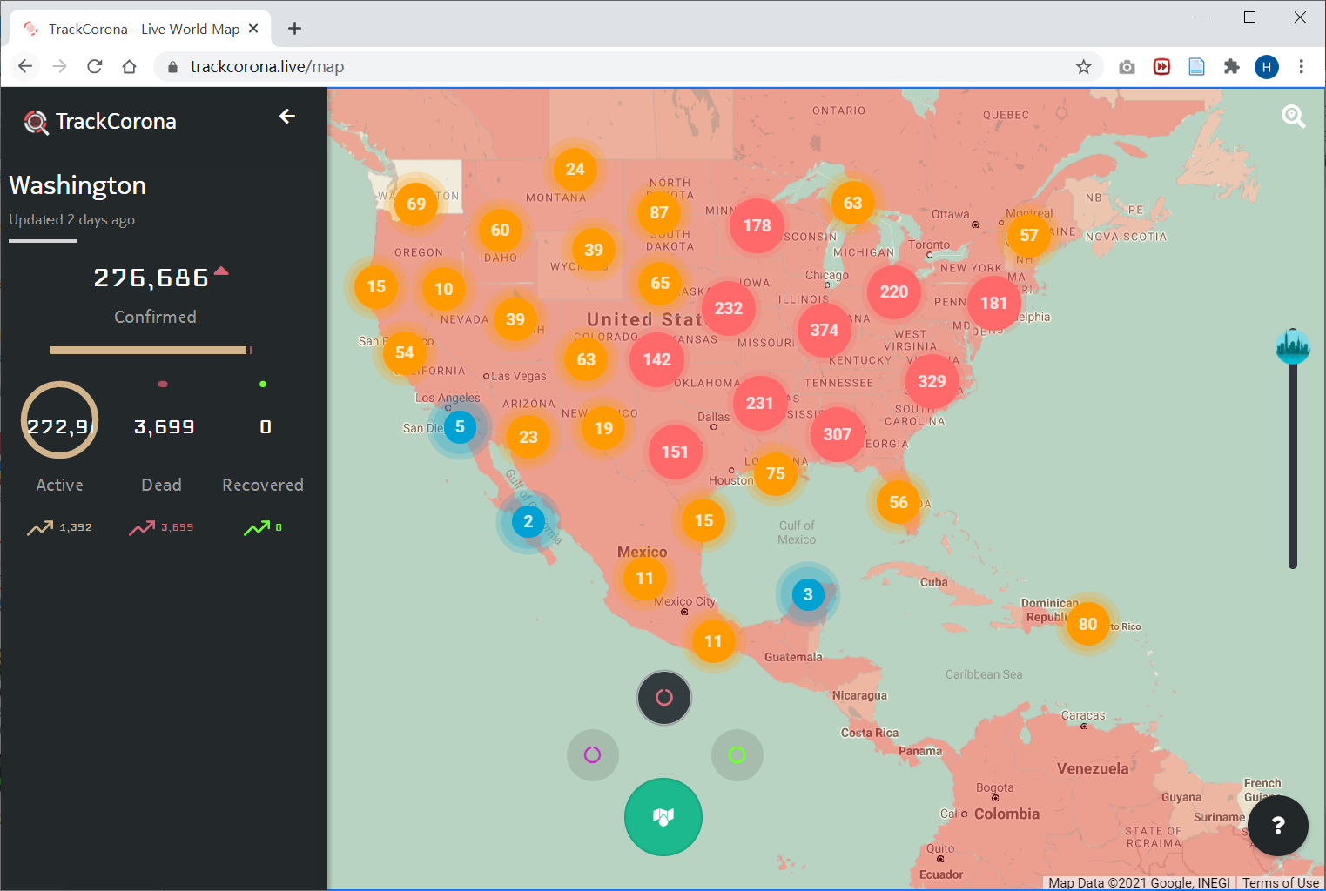
APIs and Libraries
TrackCorona:
https://www.trackcorona.live/map

Slide 11
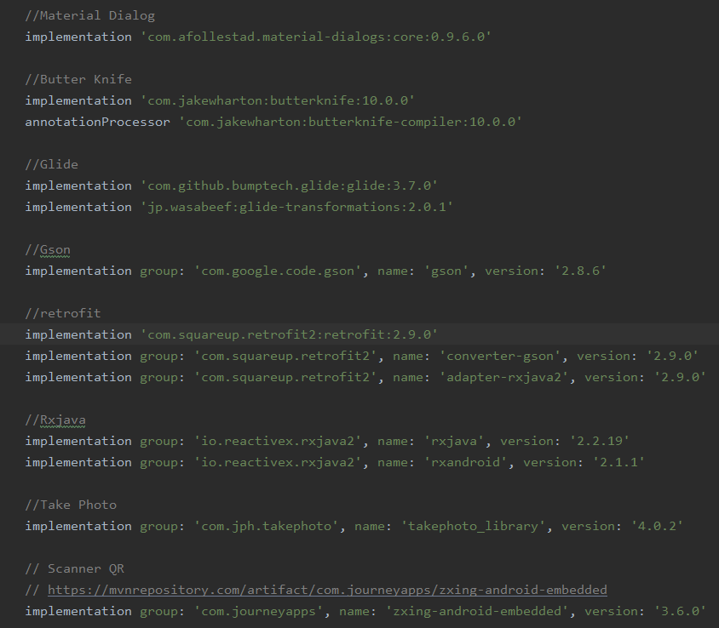
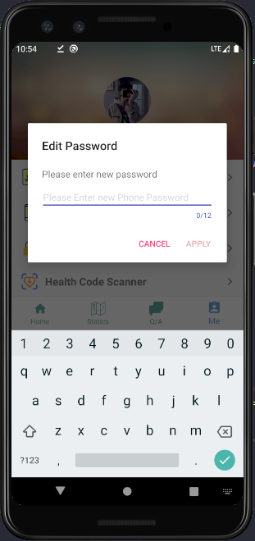
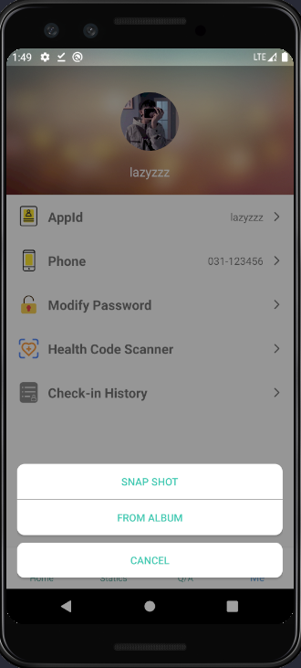
APIs and Libraries
1. Material Dialog
2. Take Photo
3. QR Code Scanner

Slide 12
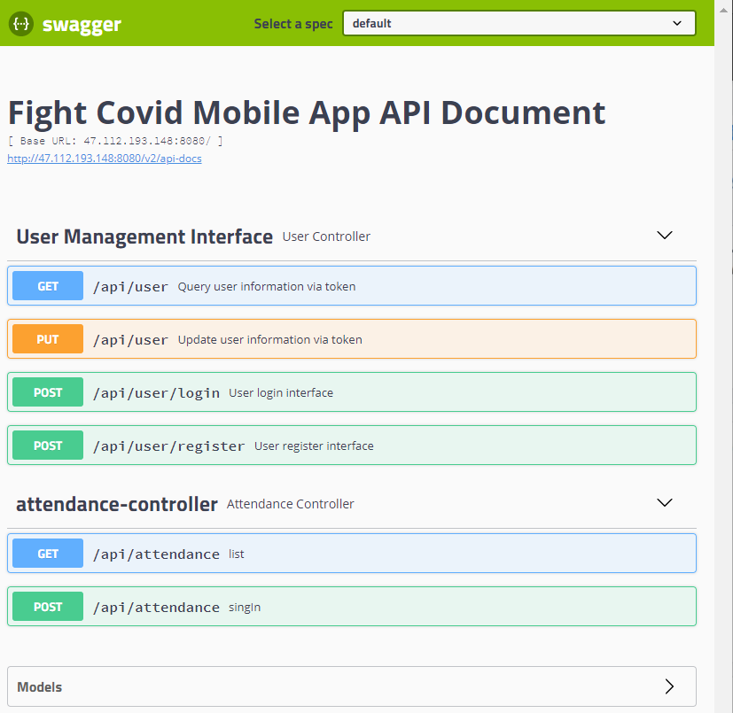

Deployment

